Slide 1
Compass ePOS Solution
App

Slide 2

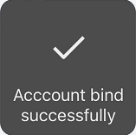

Bind Account
Consumers/Parents need to bind account at first and then access functionalities in App. There are 2 ways to bind account
Bind Account Onsite
Bind Account Remotely
Parents Visit Onsite
Parents Swipe Meal Card
Pop-up QR Code on POS Machine
Parents Scan QR Code via Wechat
Send QR Cod to Parents
Print QR code
Parents Scan QR Code via Wechat
Scan by Wechat
Scan by Wechat
Tips:
If you don’t take meal card, you can get support from cashier with providing your name, our cashier can support you to inquiry by name and print out QR code
Each account has own individual QR code

Slide 3
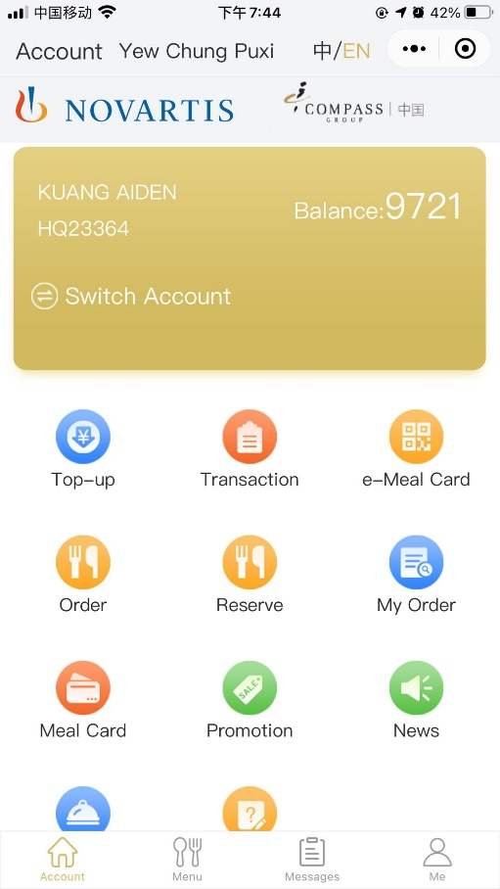
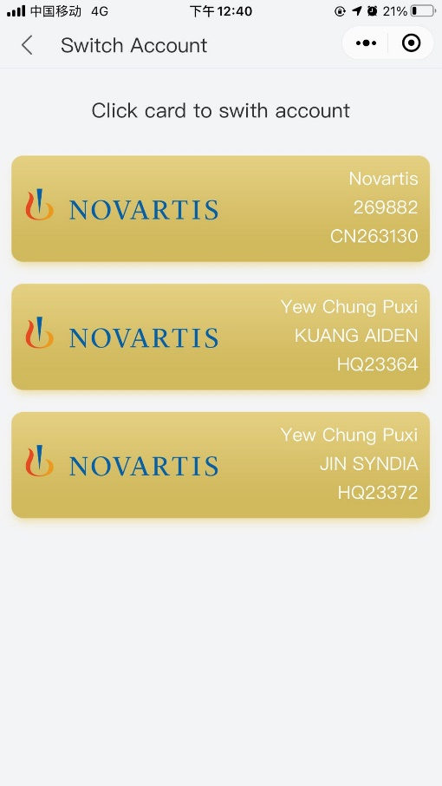
Switch Account
Consumers/Parents can switch account if have multi accounts
Open App in Wechat
Switch Account
Click account card to switch to another account

Slide 4
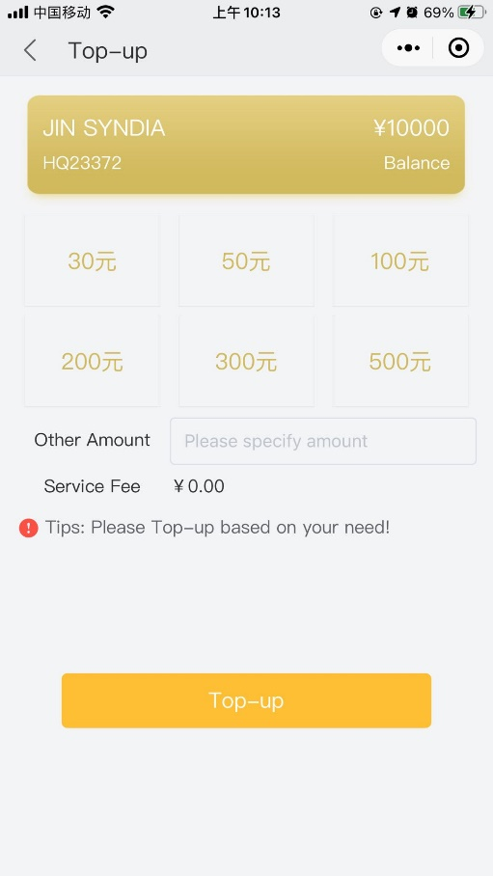
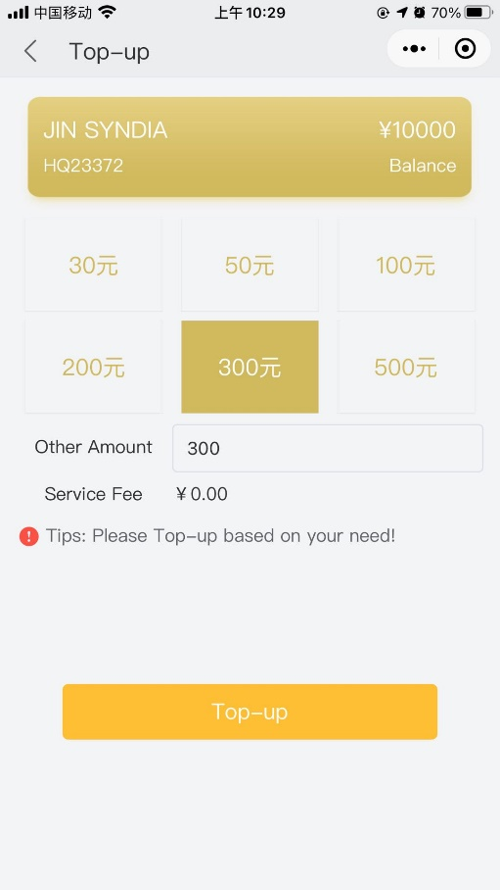
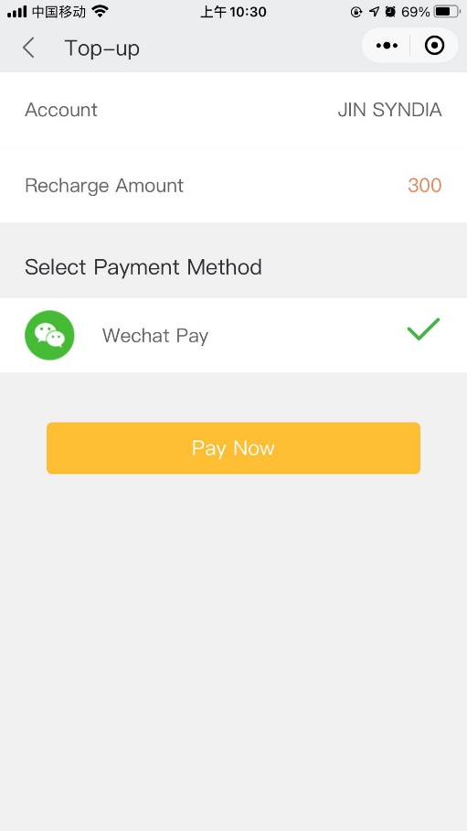
Top-up
Consumers/Parents can top-up remotely via App
Open App in Wechat
Top-up & Specify top-up amount
Confirm to pay
Pay via Wechat
Pay Now to pay by Wechat

Slide 5
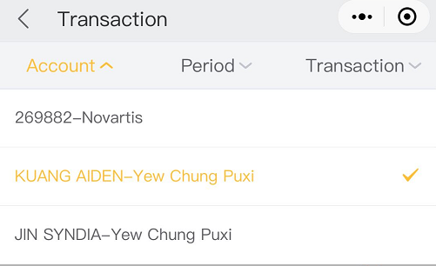
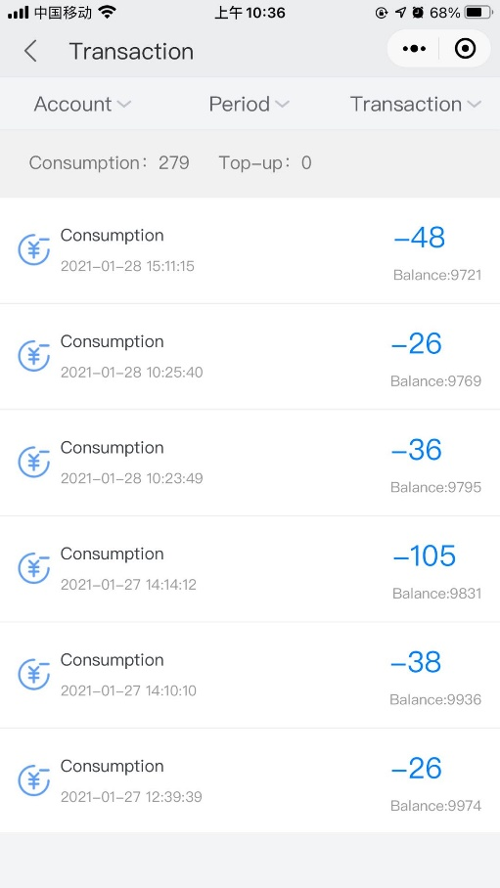
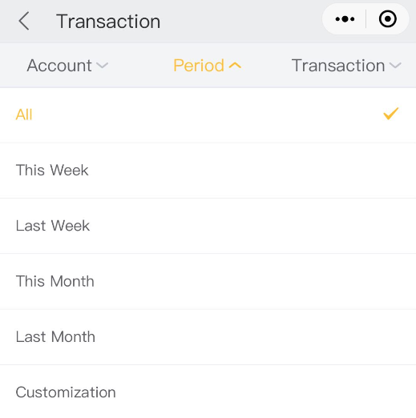
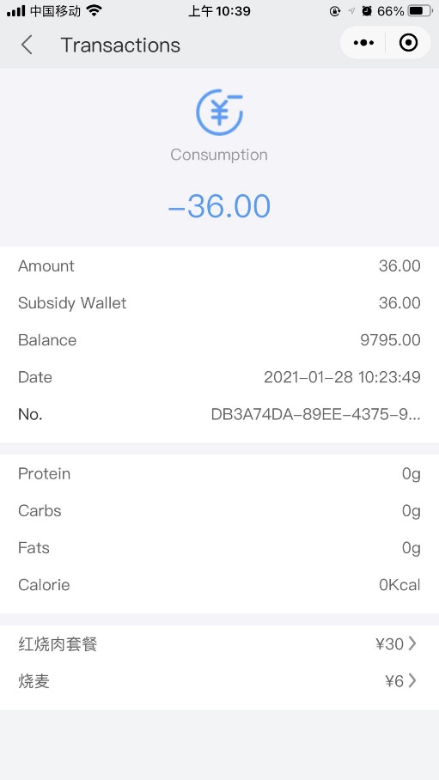
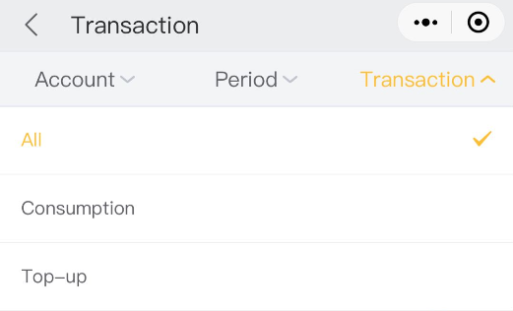
Transaction Inquiry
Consumers/Parents can inquiry transactions via App
Open App in Wechat
Inquiry Transaction
Filter by account
Subtotal for consumption and top-up
Filter by period
Filter by consumption or top-up
Detailed transaction

Slide 6
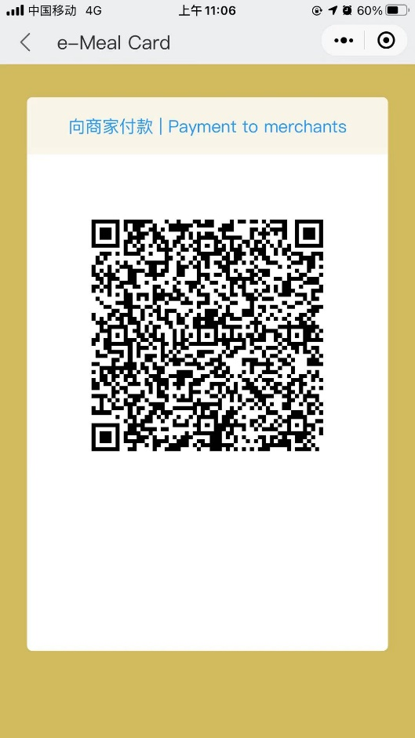
e-Meal Card
Consumers/Parents can use e-Meal Card via App for consumption instead of physical meal card
Open App in Wechat
e-Meal Card
Show QR Code to Cashier

Slide 7
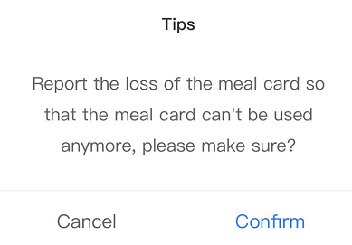
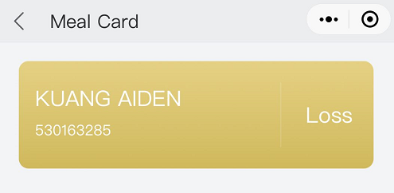
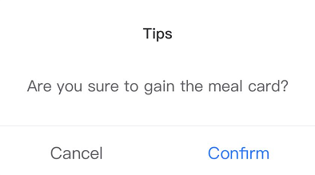
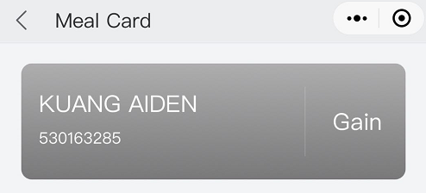
Meal Card Management
Consumers/Parents can manage meal card self via App (report to loss or gain)
Open App in Wechat
Meal Card
Loss or Gain

